Slide 1
Natural Language Processing with Disaster Tweets
Research Project
CS 834: Introduction to Information Retrieval
Presented by Tarannum Zaki
Department of Computer Science
Old Dominion University, Norfolk, Virginia
Dec 05, 2023

Slide 2
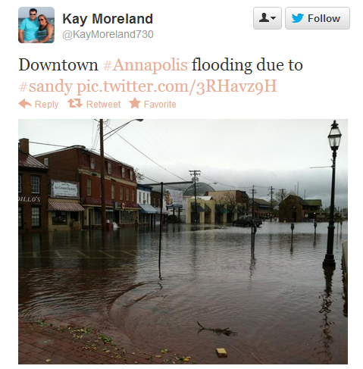
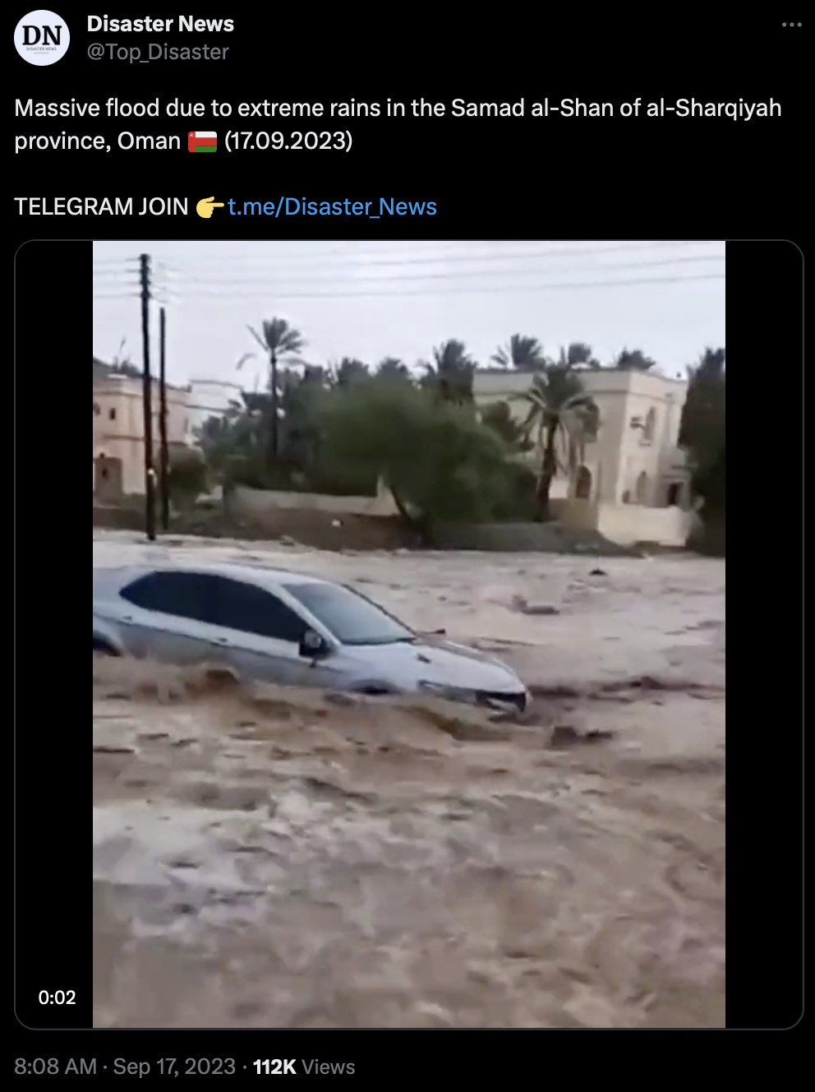

Twitter - a popular social media
Social media is one of the most popular ways of sharing information these days.
Smartphones allow sharing content during emergency situations in real-time.
Twitter has become an important communication channel in times of emergency.
Research shows that consumers use Twitter more to stay updated on breaking news.
Different agencies are interested in programatically monitoring Twitter.
Tarannum Zaki CS 834 - Intro to Information Retrieval Natural Language Processing with Disaster Tweets @tarannum_zaki @WebSciDL

Slide 3
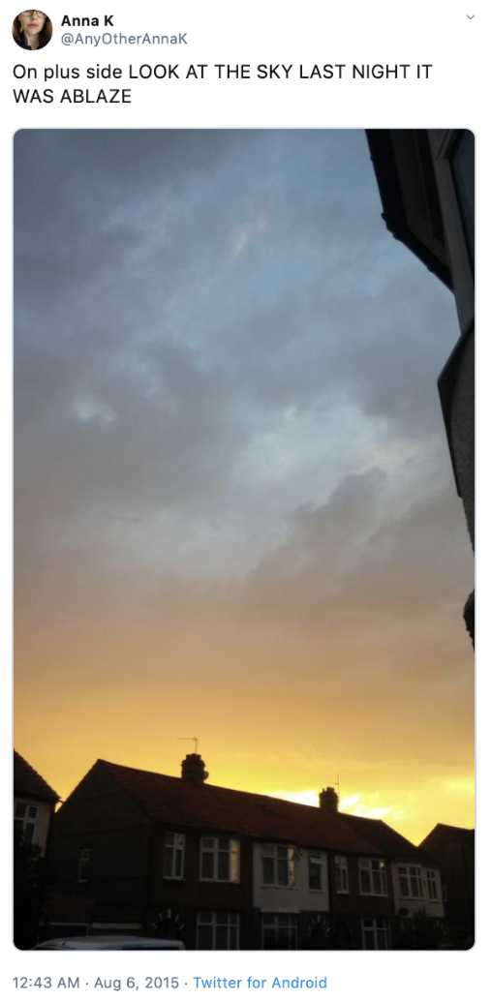
Is the author’s Tweet actually announcing a real disaster?
On plus side LOOK AT THE SKY LAST NIGHT IT WAS ABLAZE
Does ‘ABLAZE’ refer to disaster in this tweet?
https://www.kaggle.com/competitions/nlp-getting-started
Tarannum Zaki CS 834 - Intro to Information Retrieval Natural Language Processing with Disaster Tweets @tarannum_zaki @WebSciDL

Slide 4
Problem Definition
Classification Task
RQ1: Is the Tweet about a real disaster or not?
RQ2: How effectively the prediction is performed using machine learning models?
Information Retrieval Task
Task1: Search relevant disaster related tweets from the test data based on a query that includes a disaster related keyword.
Task2: Evaluate how effectively the relevant tweets are retrieved.
Tarannum Zaki CS 834 - Intro to Information Retrieval Natural Language Processing with Disaster Tweets @tarannum_zaki @WebSciDL

Slide 5
Aim of the Project
To build a machine learning model that predicts whether tweets are about real disasters or not.
To perform an information retrieval task from the classified test dataset.
Tarannum Zaki CS 834 - Intro to Information Retrieval Natural Language Processing with Disaster Tweets @tarannum_zaki @WebSciDL

Slide 6
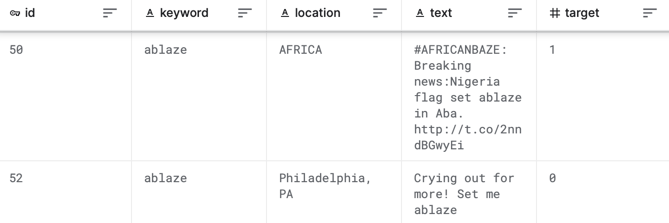
Dataset
A dataset of about 10,000 Tweets that were hand classified.
Split into training and testing dataset.
Data fields:
ID
Tweet text
Keyword
Location
Target
https://www.kaggle.com/competitions/nlp-getting-started/data
Tarannum Zaki CS 834 - Intro to Information Retrieval Natural Language Processing with Disaster Tweets @tarannum_zaki @WebSciDL

Slide 7
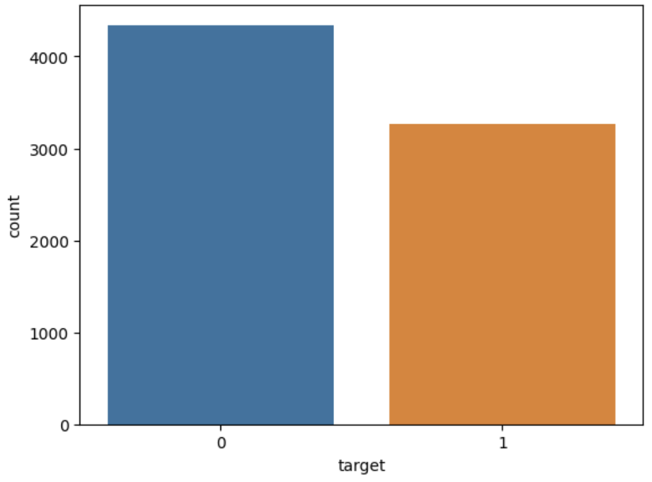
Exploratory Data Analysis (EDA)
Training dataset - 7,613 (70%) and Testing dataset - 3,263 (30%).
Both testing and training datasets have some null values for the fields ‘keyword’ and ‘location.’
Target count in training dataset:
0 : Non-Disaster Tweet (57%)
1 : Disaster Tweet (43%)
Moderately balanced dataset.
Tarannum Zaki CS 834 - Intro to Information Retrieval Natural Language Processing with Disaster Tweets @tarannum_zaki @WebSciDL

Slide 8
Methodology for Classification Problem
Traditional machine learning models
Logistic Regression
Random Forest
k-Nearest Neighbour (KNN)
Naive Bayes
Support Vector Machine (SVM)
Gradient Boosting
Feature Vectors
TF-IDF score
Word2Vec word embedding
Kowsari, K., Jafari Meimandi, K., Heidarysafa, M., Mendu, S., Barnes, L., & Brown, D. (2019). Text classification algorithms: A survey. Information, 10(4), 150, https://doi.org/10.3390/info10040150
Tarannum Zaki CS 834 - Intro to Information Retrieval Natural Language Processing with Disaster Tweets @tarannum_zaki @WebSciDL

Slide 9
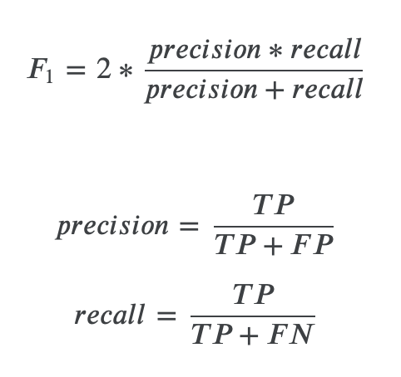
Evaluation for Classification Problem
Calculating F1 score between the predicted and expected answers:
https://www.kaggle.com/competitions/nlp-getting-started
Tarannum Zaki CS 834 - Intro to Information Retrieval Natural Language Processing with Disaster Tweets @tarannum_zaki @WebSciDL

Slide 10
Framework: Tasks for Classification Problem
Text Preprocessing (text cleaning, tokenization)
Text Numericalization (computing TF-IDF score)
Feature Vector
(combining TF-IDF score with Word2Vec word embedding)
Evaluation
(computing F1 score)
Text Classification (training and testing ML models)
Tarannum Zaki CS 834 - Intro to Information Retrieval Natural Language Processing with Disaster Tweets @tarannum_zaki @WebSciDL

Slide 11
Text Preprocessing: Training and Testing Dataset
Text Cleaning and Tokenization
Converted all to lower case
Removed URLs
Removed punctuation
Removed hashtags
Removed numbers
Removed stopwords
Using string methods, regular expression module of Python, and NLTK corpus.
Text | 13,000 people receive #wildfires evacuation orders in California
Cleaned Text | people receive wildfires evacuation orders california
Tarannum Zaki CS 834 - Intro to Information Retrieval Natural Language Processing with Disaster Tweets @tarannum_zaki @WebSciDL

Slide 12
Training Dataset Framework: Classification Problem
Train-Validation-Test Dataset Split
The training dataset is split into 20% testing, 55% training dataset, and 25% validation dataset.
Input feature: Text, Target variable: Label
Normalized TF-IDF Vectorization for each Dataset
Converting the textual data into numerical data
Word Embeddings for each Dataset
Getting word embeddings using pre-trained Word2Vec embeddings
Combining Normalized TF-IDF Features and Word Embeddings
The combined vector will have a shape having rows same as the input arrays, and the number of columns will be the sum of the original columns from TF-IDF features and word embeddings.
Training, Validating, and Testing Data
Fitting the training and validation dataset and predicting the testing data
Evaluating Model Performance
Using F1-score.
Tarannum Zaki CS 834 - Intro to Information Retrieval Natural Language Processing with Disaster Tweets @tarannum_zaki @WebSciDL

Slide 13
Performance of the ML Models on Training Dataset
Models | Labels | Precision | Recall | F1-score
Logistic Regression | 0 | 0.79 | 0.87 | 0.83
 | 1 | 0.80 | 0.69 | 0.74
Random Forest | 0 | 0.77 | 0.91 | 0.84
 | 1 | 0.84 | 0.64 | 0.73
KNN | 0 | 0.82 | 0.81 | 0.81
 | 1 | 0.75 | 0.75 | 0.75
Tarannum Zaki CS 834 - Intro to Information Retrieval Natural Language Processing with Disaster Tweets @tarannum_zaki @WebSciDL

Slide 14
Performance of the ML Models on Training Dataset
Models | Labels | Precision | Recall | F1-score
Multinomial Naive Bayes | 0 | 0.80 | 0.88 | 0.84
 | 1 | 0.82 | 0.75 | 0.75
SVM | 0 | 0.79 | 0.88 | 0.83
 | 1 | 0.81 | 0.69 | 0.74
Gradient Boosting | 0 | 0.80 | 0.79 | 0.79
 | 1 | 0.80 | 0.80 | 0.80
Tarannum Zaki CS 834 - Intro to Information Retrieval Natural Language Processing with Disaster Tweets @tarannum_zaki @WebSciDL

Slide 15
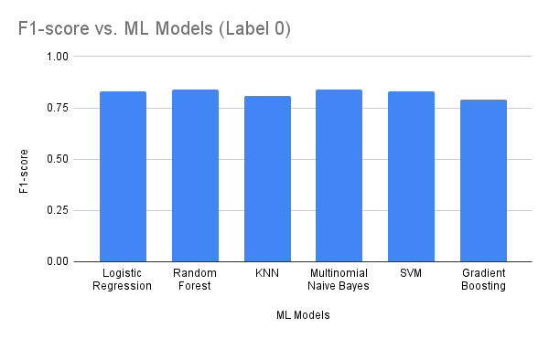
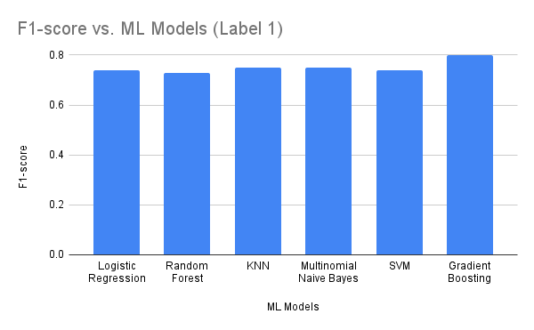
Summary of F1-score on Training Dataset
Multinomial Naive Bayes gives comparatively better F1-score for classifying label 1 and 0
Tarannum Zaki CS 834 - Intro to Information Retrieval Natural Language Processing with Disaster Tweets @tarannum_zaki @WebSciDL

Slide 16
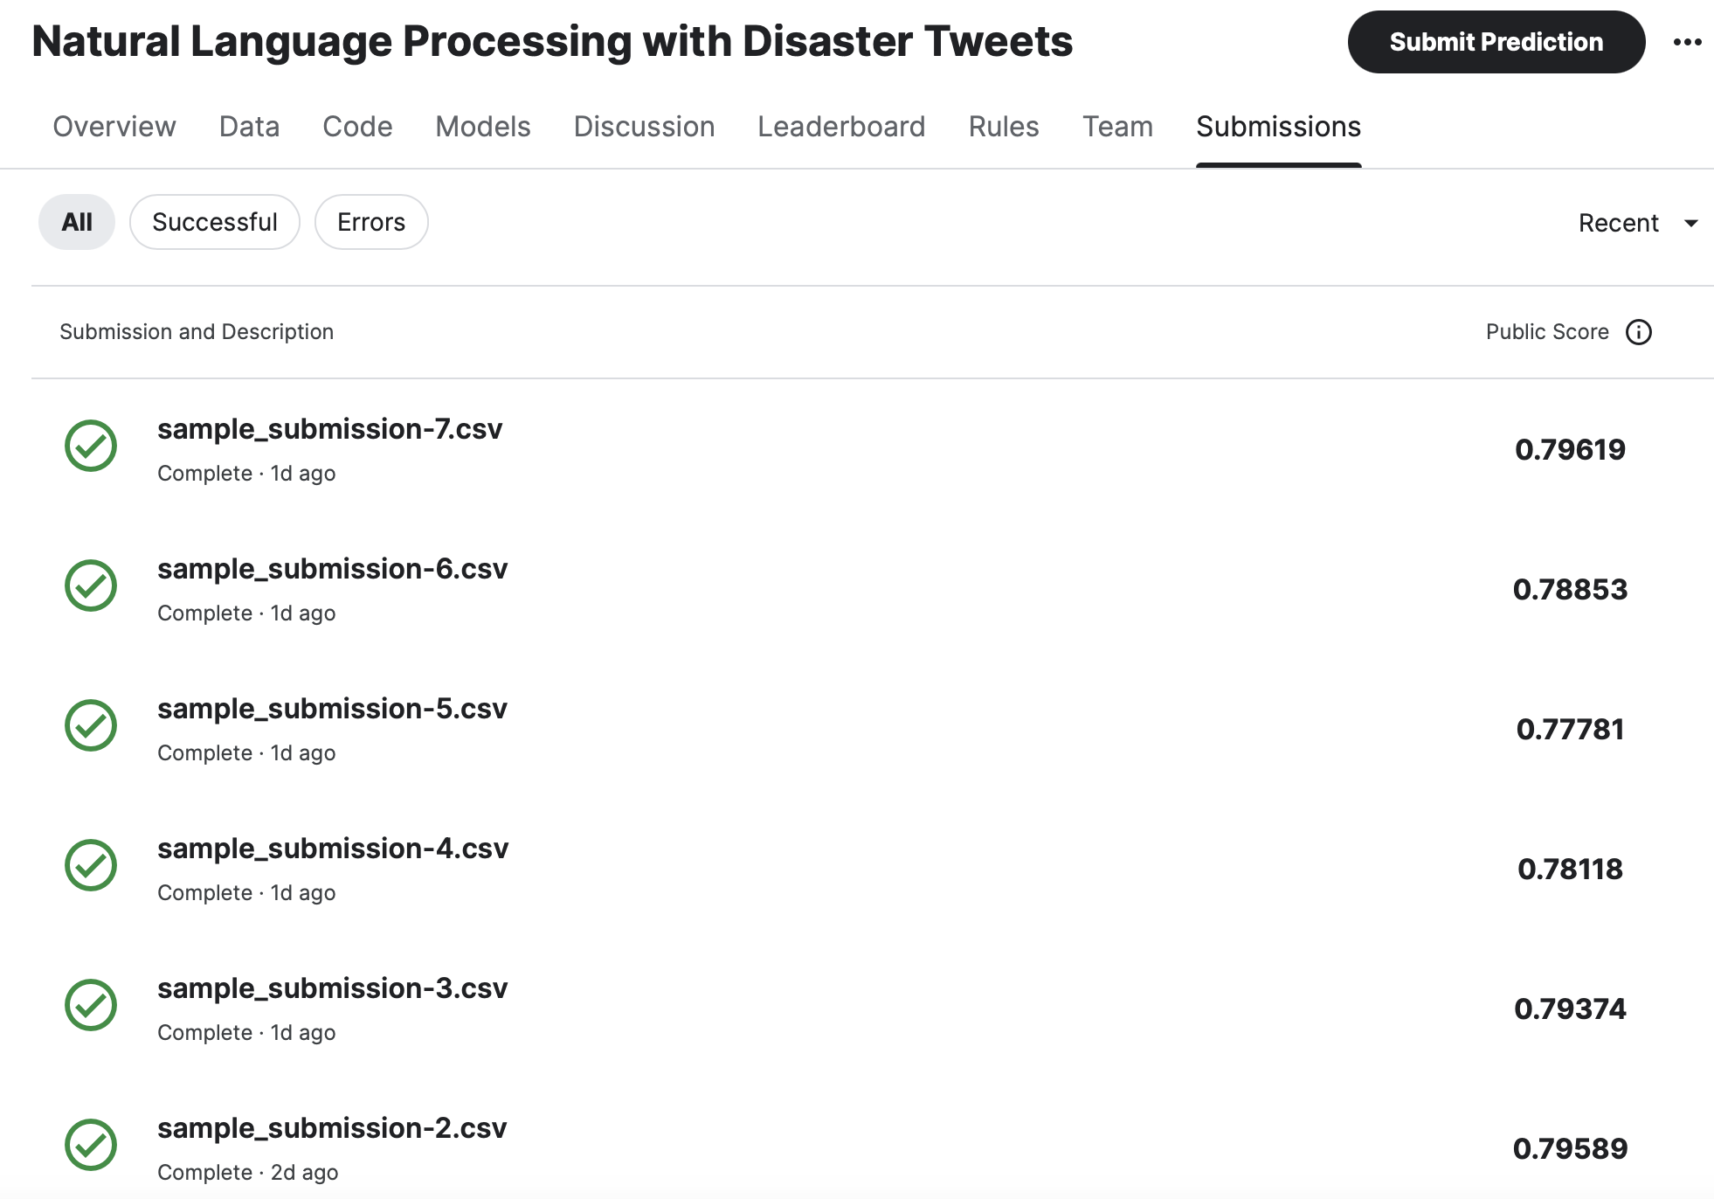
Kaggle Submission Results of Testing Dataset
Models | Public Score
SVM | 0.79619
Multinomial Naive Bayes | 0.79589
Logistic Regression | 0.79374
Gradient Boosting | 0.78854
Random Forest | 0.78118
KNN | 0.77781
Tarannum Zaki CS 834 - Intro to Information Retrieval Natural Language Processing with Disaster Tweets @tarannum_zaki @WebSciDL

Slide 17
Methodology for Information Retrieval Task
Query Keyword
Extract top 20 keywords (unigrams) having label 1 from training dataset based on normalized TF-IDF score.
Combined Feature Vector
Normalized TF-IDF score.
Word2Vec word embedding.
Dataset
Training dataset having label 1 and query keyword.
Classified testing dataset having query keyword.
Cosine Similarity Score
Weighted average of combined feature vector of the filtered training dataset.
Combined feature vector of each of the filtered classified testing data.
Tarannum Zaki CS 834 - Intro to Information Retrieval Natural Language Processing with Disaster Tweets @tarannum_zaki @WebSciDL

Slide 18
Evaluation for Information Retrieval Task
Calculating F1 score between the predicted and expected answers:
Tarannum Zaki CS 834 - Intro to Information Retrieval Natural Language Processing with Disaster Tweets @tarannum_zaki @WebSciDL

Slide 19
Framework: Tasks for Information Retrieval
Query Keyword
(extracting top 20 disaster related keywords)
Filtering Training Dataset
(label 1 and query keyword)
Filtering Classified Testing Dataset
(query keyword)
Evaluation
(computing F1 score)
Cosine Similarity
(weighted average of training data and testing data)
Feature Vector
(combining TF-IDF score with Word2Vec word embedding)
Tarannum Zaki CS 834 - Intro to Information Retrieval Natural Language Processing with Disaster Tweets @tarannum_zaki @WebSciDL

Slide 20
Training Dataset Framework: Information Retrieval Task
Filtered Dataset
Training data for label 1 and query keyword.
Testing data for query keyword.
Normalized TF-IDF Vectorization for each Dataset
Converting the textual data into numerical data
Word Embeddings for each Dataset
Getting word embeddings using pre-trained Word2Vec embeddings
Combining Normalized TF-IDF Features and Word Embeddings
The combined vector will have a shape having rows same as the input arrays, and the number of columns will be the sum of the original columns from TF-IDF features and word embeddings.
Computing Cosine Similarity Score
Between weighted average combined feature vector of training data and combined feature vector of testing data.
Evaluating Retrieval Performance
Using F1-score.
Tarannum Zaki CS 834 - Intro to Information Retrieval Natural Language Processing with Disaster Tweets @tarannum_zaki @WebSciDL

Slide 21
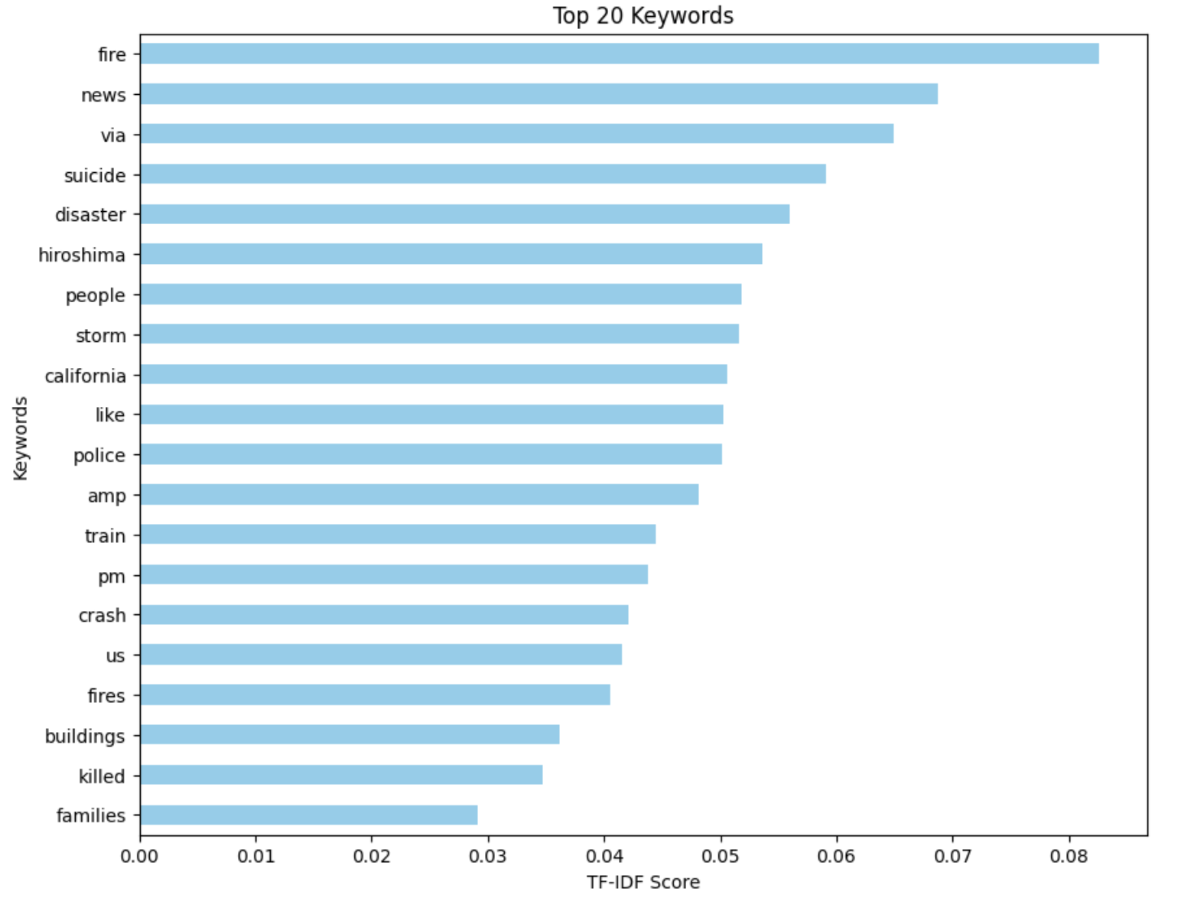
Extracting Top 20 Disaster Related Keywords
Training dataset having label 1 (disaster related labels).
Normalized TF-IDF score
Unigrams
‘fire’ is the topmost disaster related keyword.
Tarannum Zaki CS 834 - Intro to Information Retrieval Natural Language Processing with Disaster Tweets @tarannum_zaki @WebSciDL

Slide 22
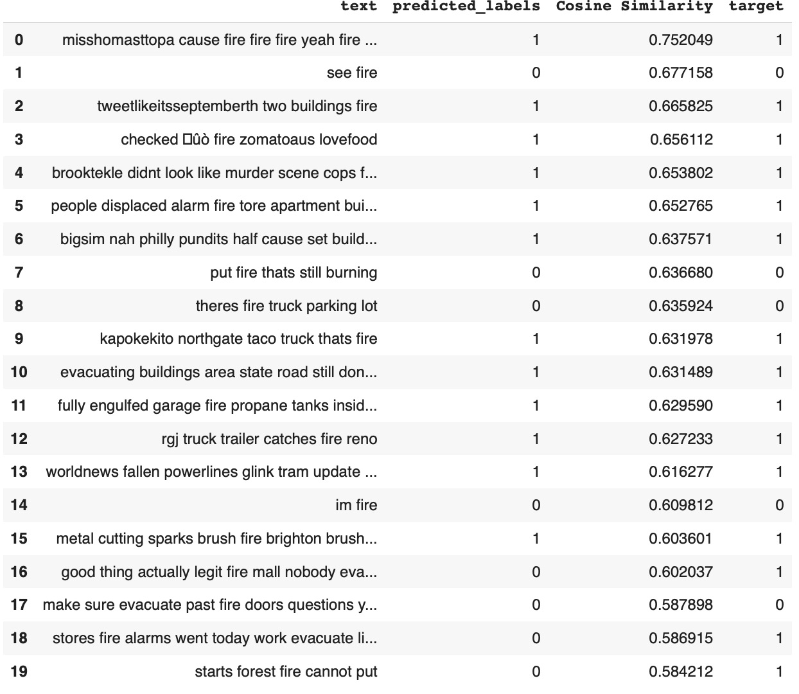
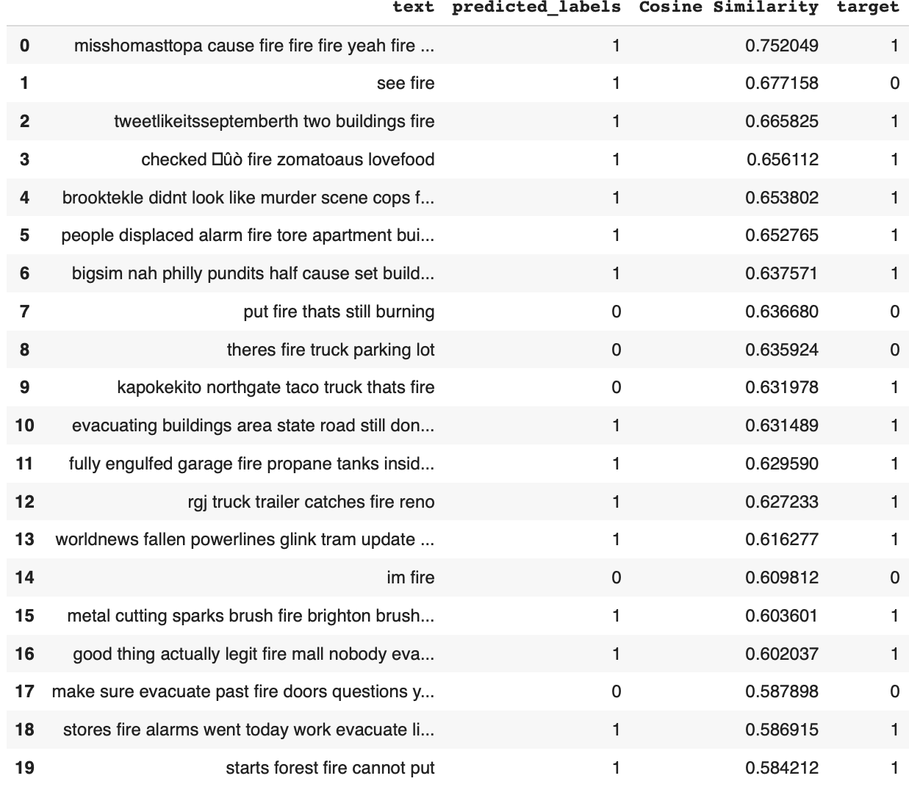
Top 20 Results on Training Dataset for the Query Keyword ‘fire’
Multinomial Naive Bayes
KNN
Tarannum Zaki CS 834 - Intro to Information Retrieval Natural Language Processing with Disaster Tweets @tarannum_zaki @WebSciDL

Slide 23
Performance of Top 20 Results on Training Dataset for the Query Keyword ‘fire’
Models | Labels | F1-score
Logistic Regression | 1 | 0.85
Random Forest | 1 | 0.79
KNN | 1 | 0.93
Multinomial Naive Bayes | 1 | 0.89
SVM | 1 | 0.85
Gradient Boosting | 1 | 0.84
Tarannum Zaki CS 834 - Intro to Information Retrieval Natural Language Processing with Disaster Tweets @tarannum_zaki @WebSciDL

Slide 24
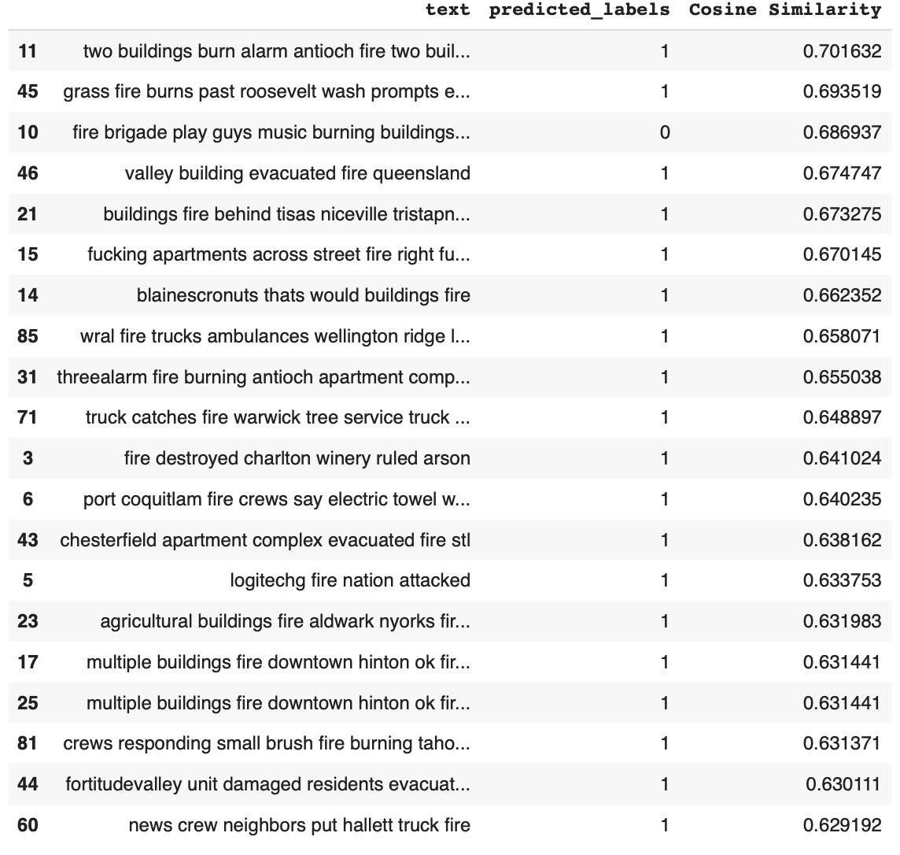
Top 20 Results on Testing Dataset for the Query Keyword ‘fire’
Multinomial Naive Bayes
Tarannum Zaki CS 834 - Intro to Information Retrieval Natural Language Processing with Disaster Tweets @tarannum_zaki @WebSciDL

Slide 25
Infrastructure
Python script
Hardware - Google Colab on personal computer.
Software - Pandas, NumPy, NLTK, Sci-kit learn, Gensim.
Tarannum Zaki CS 834 - Intro to Information Retrieval Natural Language Processing with Disaster Tweets @tarannum_zaki @WebSciDL

Slide 26
Summary
Previous works showed SVM and Multinomial Naive Bayes performed well for this dataset.
Multinomial Naive Bayes showed relatively good results for both classification and information retrieval task.
A combination of TF-IDF score and word embeddings is used to capture semantic relationship of words.
A unigram keyword based query is performed to extract disaster related tweets for the information retrieval task.
Tarannum Zaki CS 834 - Intro to Information Retrieval Natural Language Processing with Disaster Tweets @tarannum_zaki @WebSciDL

Slide 27
Further Improvement
Experimenting with other word embeddings in combination with TF-IDF score.
Comparing performance with deep learning models.
Using n-grams as query keyword.
Tarannum Zaki CS 834 - Intro to Information Retrieval Natural Language Processing with Disaster Tweets @tarannum_zaki @WebSciDL

